Slide 1


22CSP72 – PROJECT WORK II PHASE I
JAYA AND XGBOOST BASED
DDoS DETECTION FOR HAPS NETWORKS
DONE BY,
23CSR161 PRAJIT PRANAV K
23CSR163 PRANEESH C
23CSR165 PRATEEKSHA G K
SUPERVISED BY,
Ms.NANTHIYA
1

Slide 2
PROBLEM DEFINITION
Distributed Denial-of-Service (DDoS) attacks are among the most dangerous cyber threats.
Attackers flood networks with excessive traffic, making services unavailable.
Existing systems face challenges in detecting attacks efficiently.
High-dimensional network traffic increases computational complexity.
Lack of explainable and optimized DDoS detection frameworks.
OBJECTIVES
Detect DDoS attacks accurately in HAPS networks.
Reduce unnecessary network features using Jaya.
Improve classification accuracy using XGBoost.
Reduce computational time and memory usage.
Provide explainable predictions using SHAP.
Build a lightweight and efficient intrusion detection model.
2

Slide 3
LITERATURE SURVEY
Paper | Summary | Research Gap
Memory-Efficient Multi-Island Jaya Feature Selection for Large-Scale DDoS Attack Detection (IEEE 2026) | Uses CIC-DDoS2019 dataset.Jaya-based feature selection.H2O AutoML classification.Detects multiple DDoS attack types. | High implementation complexity.No explainable AI component.AutoML increases computational overhead.
Cybersecurity of High-Altitude Platform Stations: Threat Taxonomy, Attacks and Defenses With Standards Mapping—DDoS Attack Use Case (IEEE 2026) | Study HAPS.Cybersecurity threats.Identifies DDoS as a major attack.Discusses defense mechanisms. | Survey-based work.No machine learning framework.No attack detection model proposed.
Performance Analysis of Machine Learning Techniques for Server Health Monitoring Using Time Series Data Against DDoS Attacks (IEEE 2025) | ML-based DDoS detection. Server health monitoring. Uses boosting algorithms. | Detect impact after server degradation.No feature optimization technique.No explainable AI support.

Slide 4
LITERATURE SURVEY
TITLE | SUMMARY | RESEARCH GAP
Classification and Explanation of Distributed Denial-of-Service (DDoS) Attack Detection using Machine Learning and Shapley Additive Explanation (SHAP) Methods | Proposes an MLP-based DDoS detection framework that uses feature selection and SHAP to provide explainable attack predictions on the CIC-DDoS2019 dataset. | Uses MLP and SHAP-based feature importance instead of an optimization algorithm like Jaya, and is not designed specifically for HAPS networks.
An Efficient Real Time DDoS Detection Model Using Machine Learning Algorithms | Develops a real-time DDoS detection system using multiple ML classifiers with PCA-based feature selection and identifies XGBoost among the best-performing models. | Relies on PCA for feature selection and does not include Explainable AI (SHAP) or a Jaya-based optimization approach.
Towards Efficient Machine Learning Method for IoT DDoS Attack Detection | Introduces a hybrid feature selection algorithm with XGBoost and explains important features for IoT DDoS detection using feature importance. | Focuses on IoT environments with a custom hybrid feature selection method rather than Jaya optimization, and is not targeted at HAPS networks.

Slide 5
RESEARCH GAPS IDENTIFIED
After studying previous research, the following gaps were identified:
Existing methods focus mainly on improving classification accuracy.
High-dimensional features increase computational cost.
Limited use of feature optimization techniques.
Most methods do not explain why an attack is detected.
Few solutions are specifically designed for HAPS environments.
Need for a lightweight, explainable, and efficient detection framework.
5

Slide 6
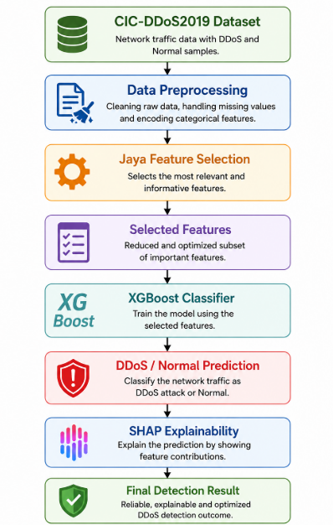
ARCHITECTURE DIAGRAM

Slide 7
PROPOSED WORK WITH PLANNED INNOVATION
PROPOSED WORK
The proposed system combines feature optimization, machine learning, and explainable AI to improve DDoS detection.
Step 1 – Apply Preprocessing techniques to Preprocess the CIC-DDoS2019 dataset.
Step 2 - Preprocess the dataset by removing missing values and converting labels.
Step 3 - Apply Jaya Algorithm to select the most important network features.
Step 4 - Train an XGBoost classifier using the selected features.
Step 5 - Predict whether the traffic is: (Normal/DDoS Attack)
Step 6 - Use SHAP to explain which features influenced the prediction.

Slide 8


PLANNED INNOVATION
Our project introduces several improvements over existing work:
Jaya for optimized feature selection.
Lightweight XGBoost classifier with reduced computational complexity.
SHAP-based explainable AI for transparent predictions.
Optimized specifically for HAPS network security.
Faster detection using fewer but more informative features.
Improved scalability for future 5G/6G communication systems.

Slide 9
MODULES OF THE PROJECT
Data Preprocessing Module
Jaya Feature Selection Module
XGBoost Model Training Module
DDoS Attack Classification Module
Model Evaluation
SHAP Explainability
Result Visualization & Deployment Module

Slide 10
THANK YOU!

